Slide 1
Test Drive Labs An Introduction to Open Telemetry with F5 BIG-IP and
Greg Coward – Sr. Solutions Architect, F5
Sanjay Shitole – Solutions Architect, F5
Joe Kanagusuku – Business Development Manager, F5
Tuesday, June 25, 2024

Slide 2



Our Team
Greg Coward
Sr Solutions Architect
Sanjay Shitole
Solutions Architect
Joe Kanagusuku
Business Development Manager

Slide 3
Logging in to the course
You would have received an email instructing you to create an account on F5 Unified Demo Framework
As per the email you received yesterday – you need an account to log into the F5 Unified Demo Framework (including 2FA)
Did you create an account prior to today’s course?
If so – Great work!!!!
If not – Please follow the instructions in that email now

Slide 4
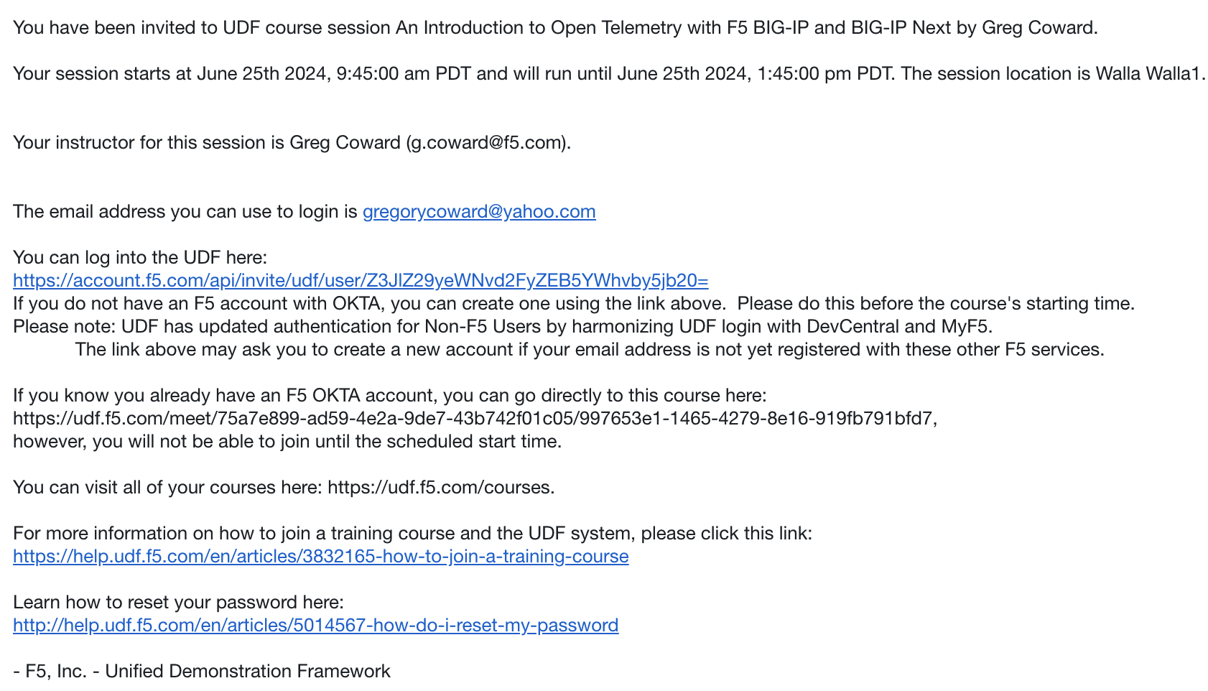
Logging into the course
Click on this link to log in and join the course

Slide 5
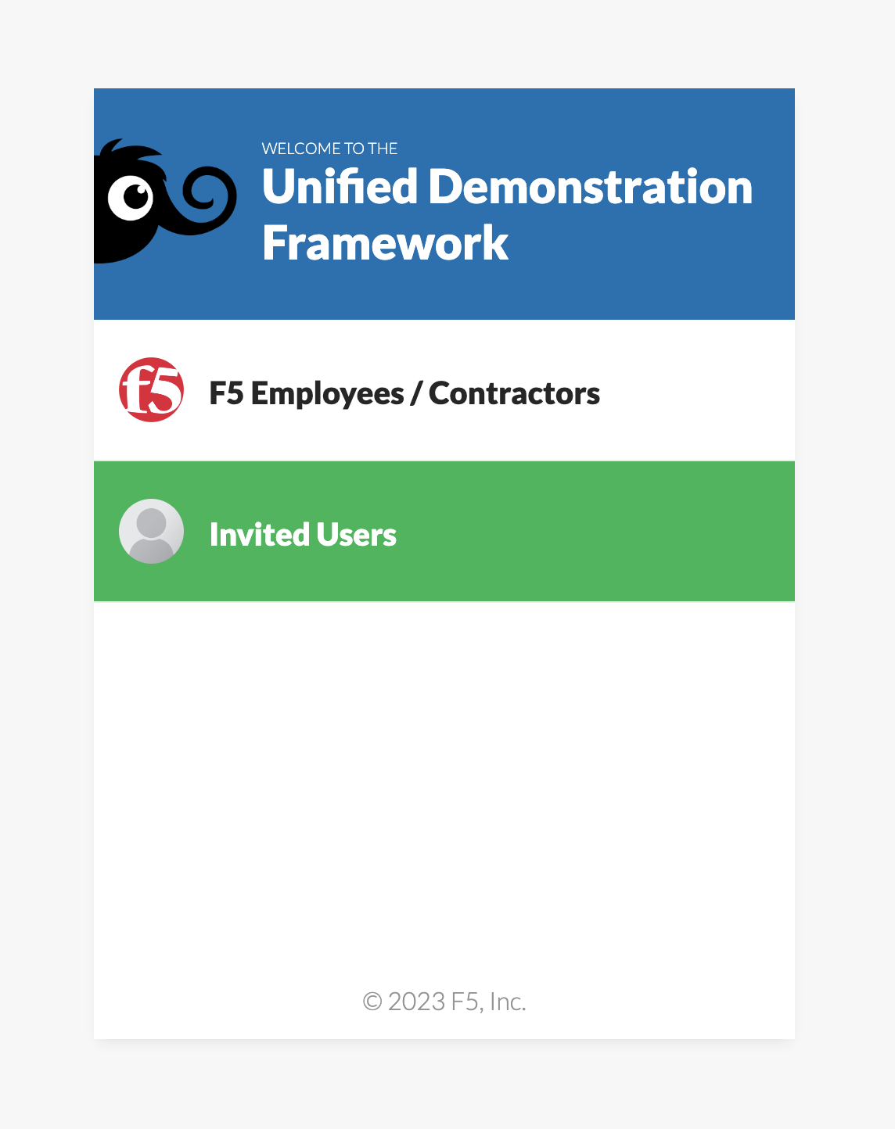
Logging in to the course
Click “Invited Users”

Slide 6
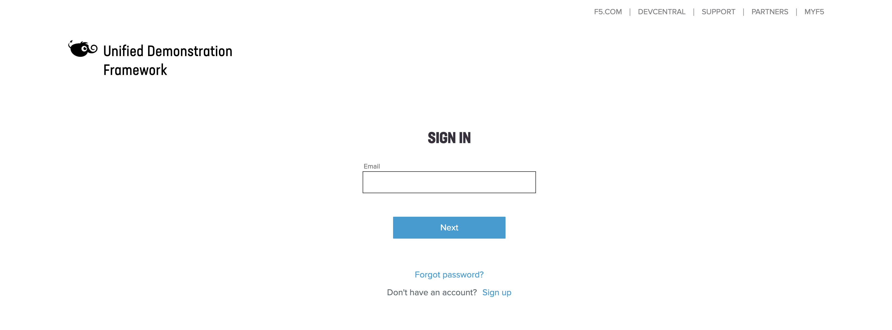
Logging in to the course
Log in with the credentials you set up yesterday

Slide 7
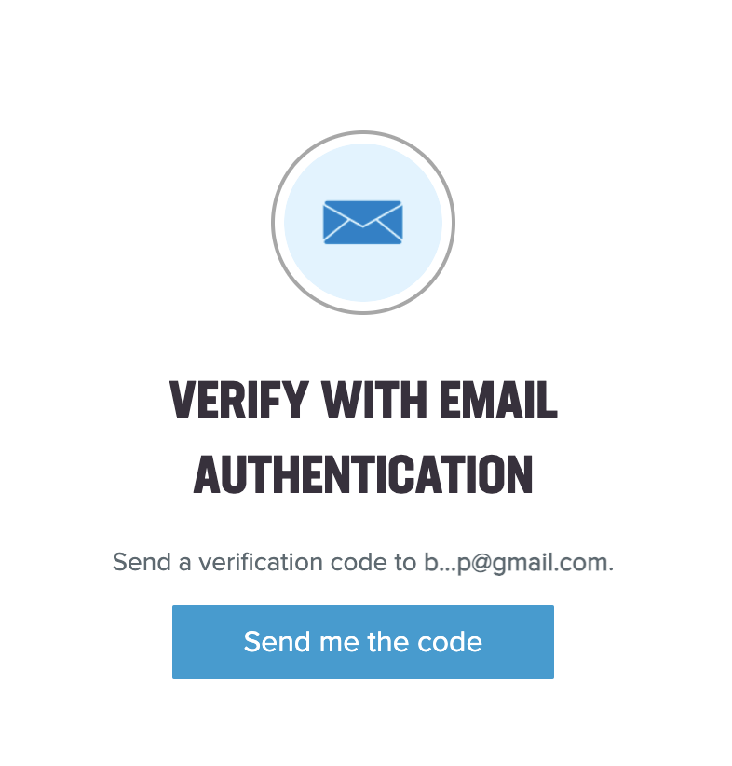
Logging in to the course
Verify with 2FA you set up when you created your account

Slide 8
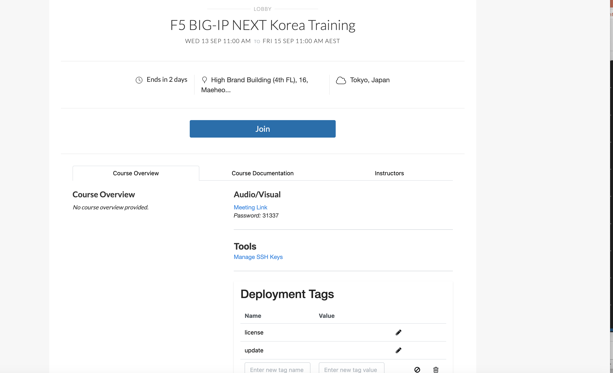
Logging in to the course
Join the session
Click on this link to log in and join the session

Slide 9
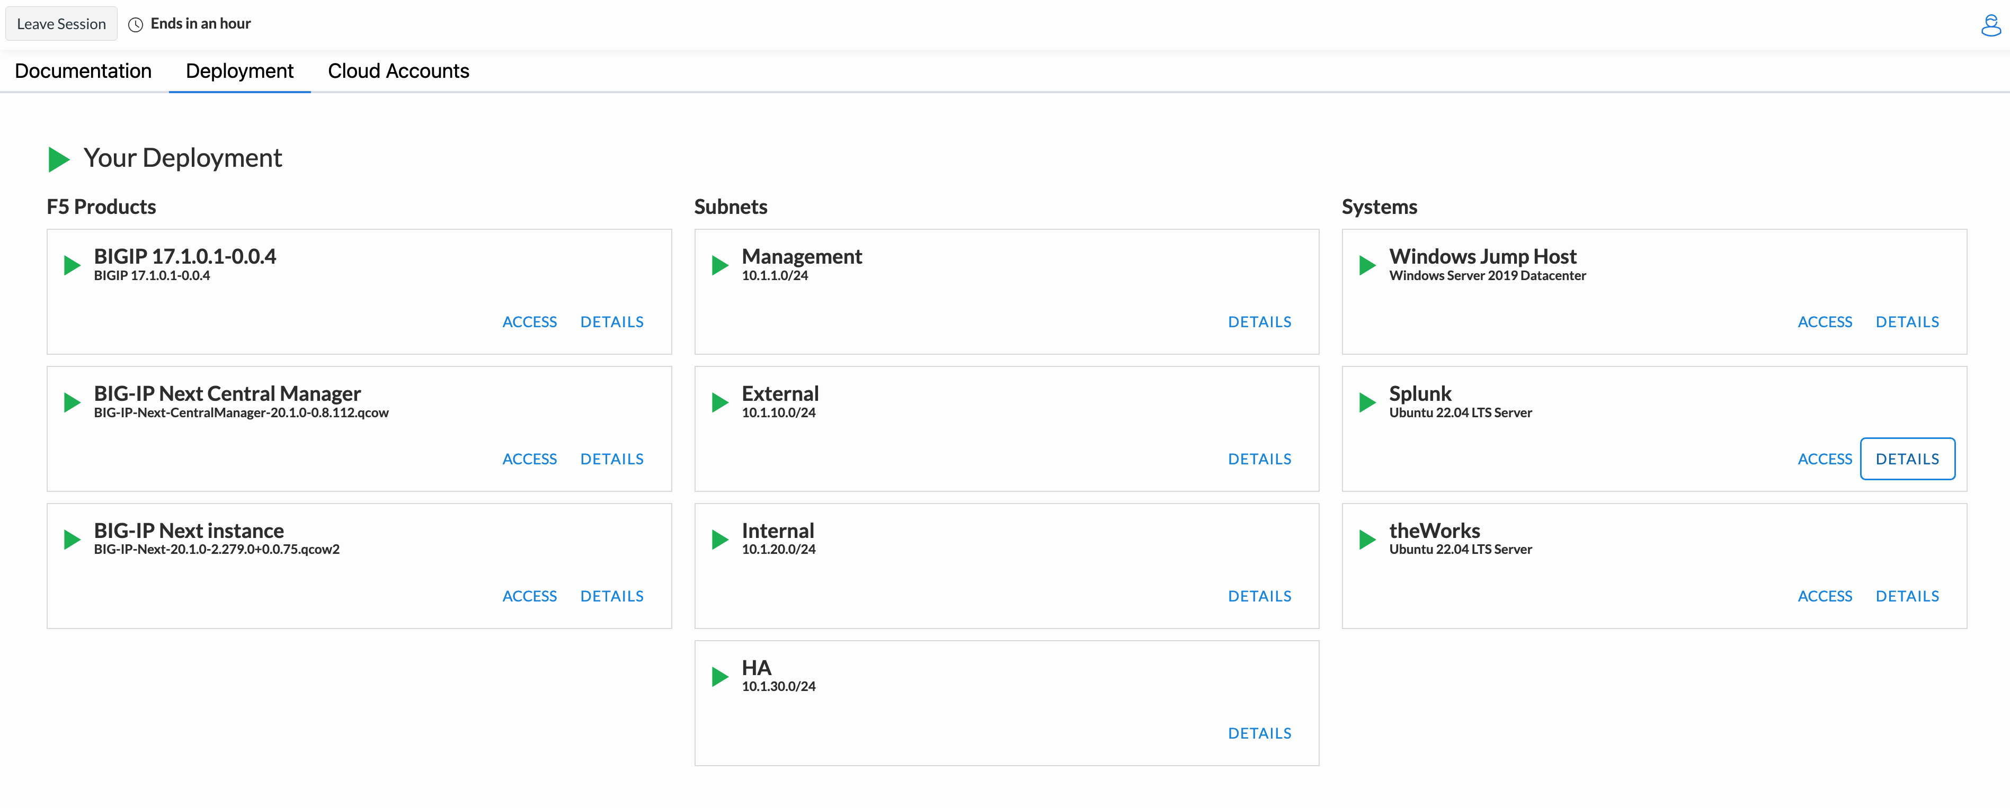
Logging in to the course
Verify your deployments are starting

Slide 10
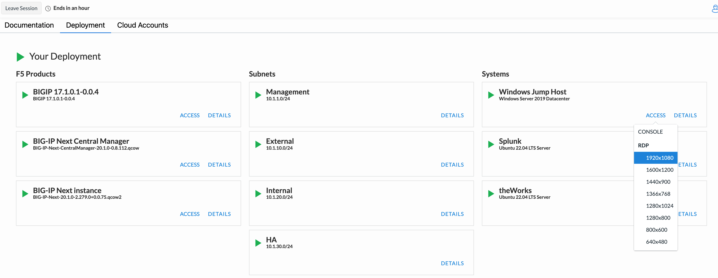
Logging in to the course
Verify your deployments are starting

Slide 11

Agenda
Open Telemetry Primer
Lab1 – App instrumentation walk-through and troubleshooting
Lab2 – Exporting BIG-IP metrics using the Open Telemetry TS consumer
Lab3 – Exporting BIG-IP Next logs using Open Telemetry
Q & A

Slide 12
What is Open Telemetry
OpenTelemetry (OTel) is an open-source observability framework for cloud-native software, which enables developers to collect, process, and export telemetry data (metrics, logs, and traces) to monitor and understand software performance and behavior.
Unified Standard: Provides a single set of APIs, libraries, agents, and instrumentation for capturing telemetry data.
Vendor-Neutral: Works with various backends and tools, avoiding vendor lock-in.
Comprehensive Monitoring: Helps in diagnosing issues, optimizing performance, and ensuring reliable operations of distributed systems.
Open Telemetry is not….
Not a Monitoring Tool: It doesn't directly monitor your applications; it collects and exports telemetry data for use with other monitoring tools.
Not a Storage System: It doesn't store telemetry data. You'll need a backend like Prometheus, Jaeger, or a commercial observability platform for storage and analysis.
Not a Visualization Tool: It doesn't provide dashboards or visualizations. Use tools like Grafana or Kibana for visualizing the collected data.
Not a Compete Solution: It’s a part of the observability stack, not a standalone solution.

Slide 13
OTel Components
The Specification
Sets cross-language standards and expectations for all implementations. This ensures consistency and interoperability across different systems and languages in the observability stack.
API
Defines data types and operations.
For generating and correlating tracing, metrics, and logging data.
SDK
Outlines requirements for language-specific API implementation.
Includes configuration, data processing, and exporting.
Data
Defines the OpenTelemetry Protocol (OTLP).
Establishes vendor-agnostic semantic conventions for telemetry backends.
Language-specific API & SDK implementations
OpenTelemetry also has language SDKs that let you use the OpenTelemetry API to generate telemetry data with your language of choice and export that data to a preferred backend. These SDKs also let you incorporate instrumentation libraries for common libraries and frameworks that you can use to connect to manual instrumentation in your application.

Slide 14
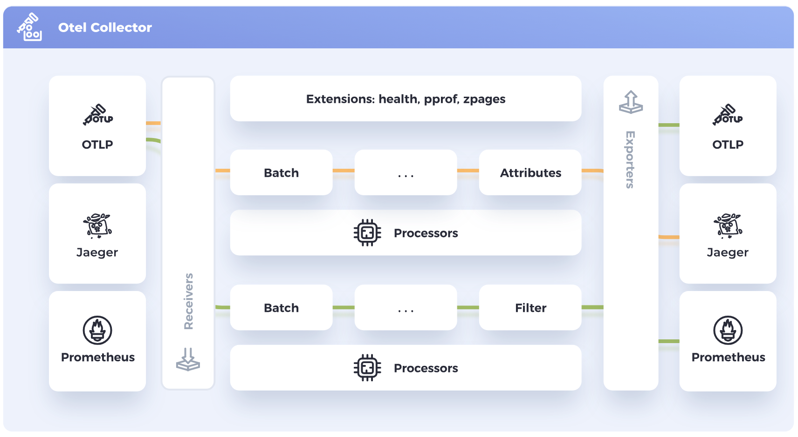
OTel Components
Collector
The OpenTelemetry Collector is a vendor-agnostic proxy designed to receive, process, and export telemetry data. It supports receiving data in multiple formats, including OTLP, Jaeger, Prometheus, and many commercial/proprietary tools.
The Collector can send this data to one or more backends for storage and analysis. It also has the capability to process and filter telemetry data before exporting it, allowing for efficient data management and customization based on specific needs.

Slide 15
OTel Components
Kubernetes Operator
The OpenTelemetry Operator is an implementation of a Kubernetes Operator. The operator manages the OpenTelemetry Collector and auto-instrumentation of the workloads using OpenTelemetry.
Function as a Service assets
OpenTelemetry supports various methods of monitoring Function-as-a-Service provided by different cloud vendors. The OpenTelemetry community currently provides pre-built Lambda layers able to auto-instrument your application as well as the option of standalone Collector Lambda layer that can be used when instrumenting applications manually or automatically.

Slide 16
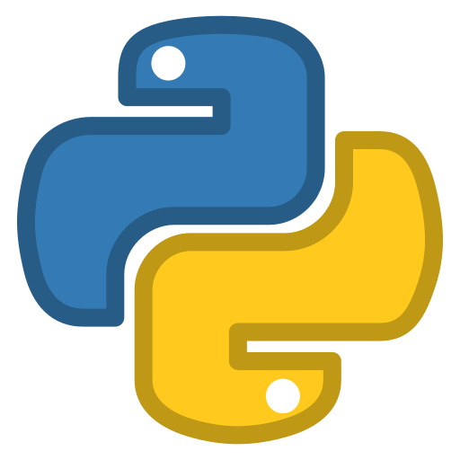





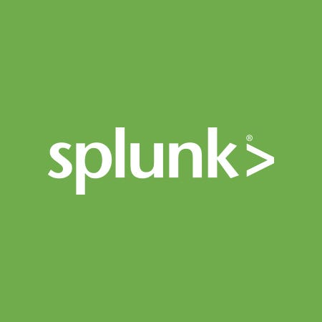
The Open Telemetry Lab
Sample Application
Python App
Traces
Observability
Direct delivery via OTLP
Redis database
Traces
Jaeger
Traces
Traces
OTLP proxy thru Collector
Collector Gateway
Metrics
Prometheus
BIG-IP
Virtual Edition
Metrics
via OTLP
BIG-IP Next
Logs
Logs
Splunk
via OTLP

Slide 17
Helpful Links
Open Telemetry
Open Telemetry Documentation - https://opentelemetry.io/docs/
OTEL Collector - https://opentelemetry.io/docs/collector/
Collector Contrib GitHub Repo - https://github.com/open-telemetry/opentelemetry-collector-contrib
F5 Portfolio
F5 Telemetry Streaming - https://clouddocs.f5.com/products/extensions/f5-telemetry-streaming/latest/
F5 Application Services 3 Extension - https://clouddocs.f5.com/products/extensions/f5-appsvcs-extension/latest/
F5 BIG-IP Next Documentation – https://clouddocs.f5.com/bigip-next/latest/
BIG-IP Next Remote Logging - https://clouddocs.f5.com/bigip-next/latest/support/cm_how_to_remote_logging_gui.html

